Slide 1
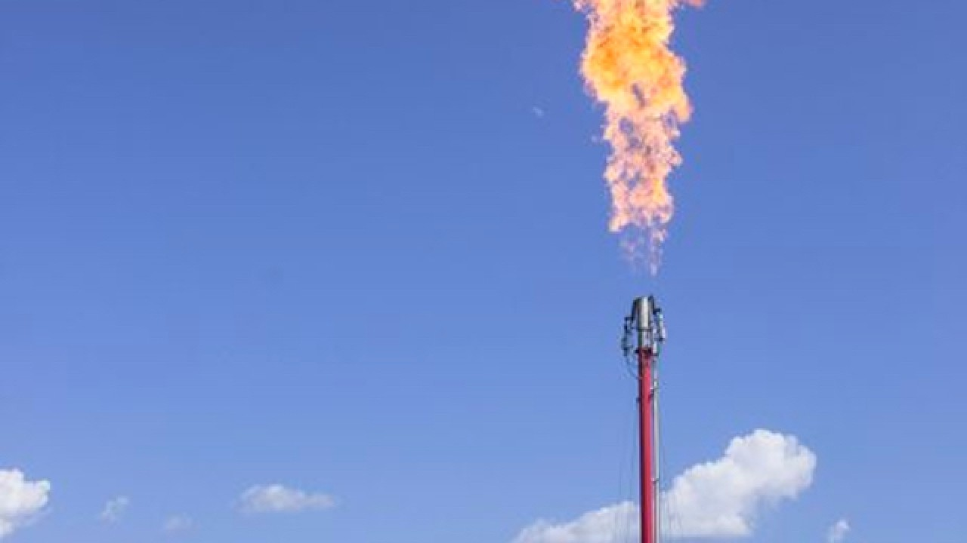
Wasted Energy:
An analysis of energy wasted to flaring
By Chad Hutchison

Slide 2
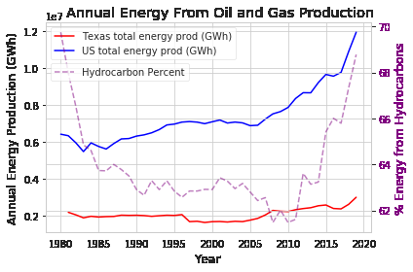
Why
Energy drives the global economy – wasting it is bad
Oil and gas represent a huge portion of energy consumption
Solving problems begins with quantifying them

Slide 3
Goals
Evaluate the scale of energy waste
Compare energy waste ratio between Texas and the US
Provide real world perspective on scale of waste
Build a foundation for future examination

Slide 4
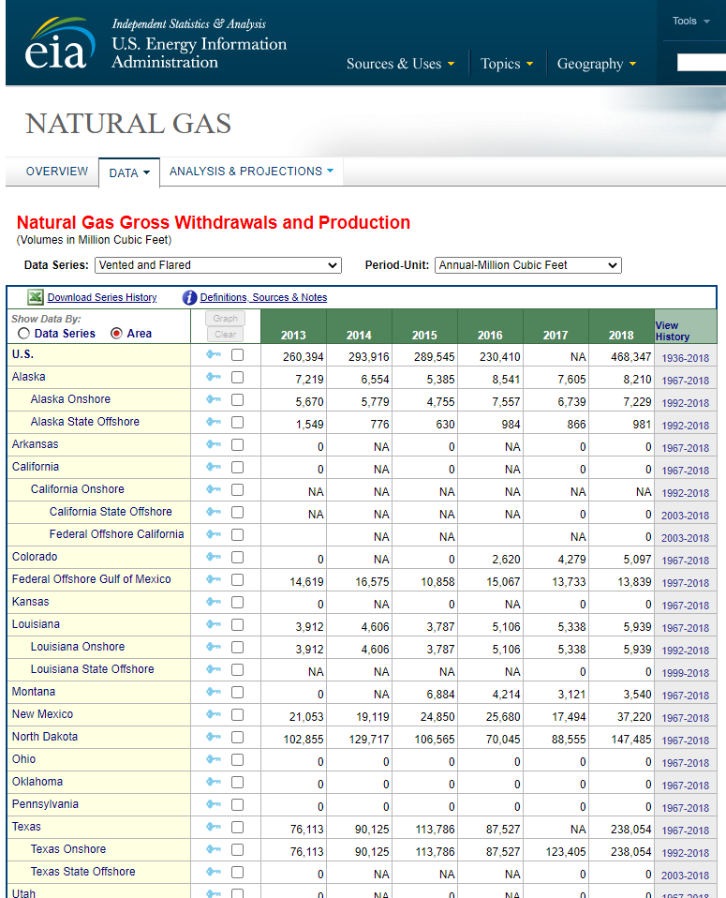
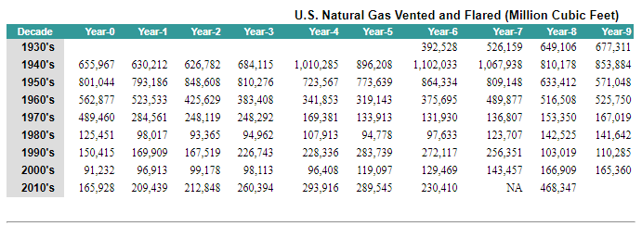
Data
By State Flared
By State Crude Oil produced
By State Natural Gas production

Slide 5
Test
Compare the ratio of flared energy to energy produced in Texas and US
Ho: The mean energy waste ratio between Texas and the US is the same
Ha: The mean energy waste ratio between Texas and the US is different
Method: Welch’s t-test between US and Texas
Alpha: 0.05

Slide 6









Tech

Slide 7
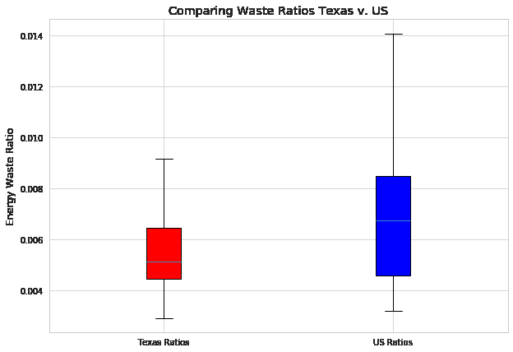

Results
Waste ratio:
$\frac{kWh wasted (flared)}{kWh produced (from oil + gas)}$

Slide 8
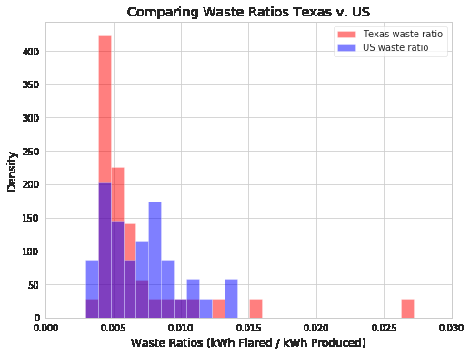
Results
Welch’s t-test results:
P-value: 0.54
α: 0.05
FAIL to reject the null Hypothesis

Slide 9
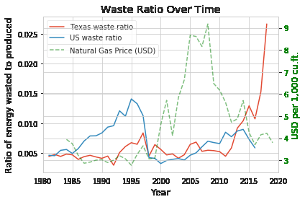
Perspective
The cost to bring to market drives the need to flare

Slide 10
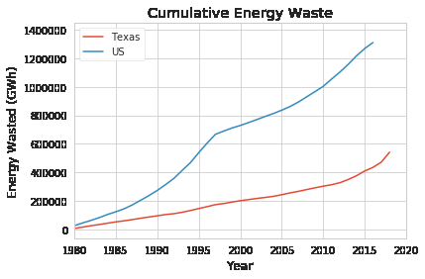
Perspective
What could have been:
Total energy wasted since 1980:
Power 161 million homes for a year
Total energy wasted in 2018 alone:
Send a Tesla to the sun and back over 3,000 times*

Slide 11
Next Steps
Compare waste of all states to US / Texas
Retrieve data from states known to flare but not reporting
Add location data to flare sites in US
Compare with map of network connectivity
Use the energy for…?
Go global

Slide 12

The End
Email:
chad.b.Hutchison@gmail.com
Github:
www.github.com/chad-hub
LinkedIn:
https://www.linkedin.com/in/chad-hutchison-b1670657/

